Slide 1


Walmart Sales Analysis
By :
Aishwarya Mohan Iyengar
Mounica Bachu
Swathi Badicole

Slide 2
INDEX
Abstract
Introduction
Novelty of Idea
Related Work
Dataset Description
Methods
Results
Discussion
Future Work
Course work Implementation
What did we learn from project
References

Slide 3
Abstract
Visualization helps to understand the results of data analysis quickly and concisely in the entire process of collecting, cleaning and analyzing data.
The aim of our project is to load, transform and analyze the Walmart sales data by creating an interactive dashboard on tableau which provides insights on yearly sales, monthly sales, weekly sales, department wise sales of Walmart stores.
This helps to give cognizance on overall performance of the stores. This can help management on decision making to improve their sales.

Slide 4
Introduction
Walmart was first opened in 1962 as a single discount store by Rogers over the intention of selling more items with less price as their tagline “Everyday low prices on a broad assortment- anytime, anywhere” .
As per our research Walmart has 4,743 stores in the U.S. along with 599 Stores of Sam’s Club and 6,101 Walmart International stores which concludes up to 11,443 stores overall.
This store has several subsidiaries in various geographical locations which is difficult for retailers to track the business profits and understand the customer needs.

Slide 5
Novelty of Idea
In our literature survey we found that there is no literature that is entirely concentrated on sales.
We have created an interactive dashboard for our analysis focused on sales of Walmart which is entirely interactive in nature.
We did not find any literature that created an interactive dashboard of sales analysis rather they were only focused on getting insights from the data such as, in the fourth quarter which store has more growth.
With our visualization we made it easy for the retailers to analyze the sales of their store by making it interactive in nature where the number of insights we get is not fixed in nature and can keep changing depending on the user's requirement .

Slide 6
Related Work
In the year 2018, 5 authors namely Alper Sarikaya, Michael Correll, Lyn Bartram, Melanie Tory, Danyel Fisher joined and did research on dashboard in tableau. This literature review suggests a various number of fruitful research directions to better support the dashboard design, implementation and also, they have explained the proper way for the end user to use it.
We mainly got an idea of the spacing that should be done in a standard dashboard creation. Visual features are explained for the new dashboard creators to know the standards to be maintained like construction and Composition, Multipage, Interactive Interface, Highlighting and annotation, Modify data or world. They have also discussed a lot about the representation of different data in different ways like social data as context, sales data as context etc.

Slide 7
Dataset Description
As we have chosen to do the interactive dashboard for the Walmart sales analysis, we wanted a dataset which contains the details of the sales happening.
We were able to locate an appropriate data from Kaggle https://www.kaggle.com/c/walmart-recruiting-store-sales-forecasting/data
Dataset consists of information about weekly sales of 45 stores along with 99 departments for a period of 3 years. Overall records in our data is 4,21,570.

Slide 8
Methods
Data Collection
Data Pre-Processing
Visualization Design
Tableau Operation

Slide 9
Data Collection
Dataset obtained from kaggle contains five different files namely,
Stores
Features
Train
Test
Sample Submission
Data which is important for data visualization has been considered and joined such as features, Stores and Training data file to create a dataframe using pyspark in jupyter notebook.

Slide 10
Data Preprocessing
What is Data Preprocessing
Why do we need it
How did we Preprocess our data
Outcome of our data Preprocessing

Slide 11

Visualization Design
Charts Used
Bar Charts
Line Charts
Area Charts
Containers
Single Valued container
Double Valued Container
Parameter
Date Granularity Parameter
Filters
Single Valued List
Multiple Values DropDown
Slider

Slide 12
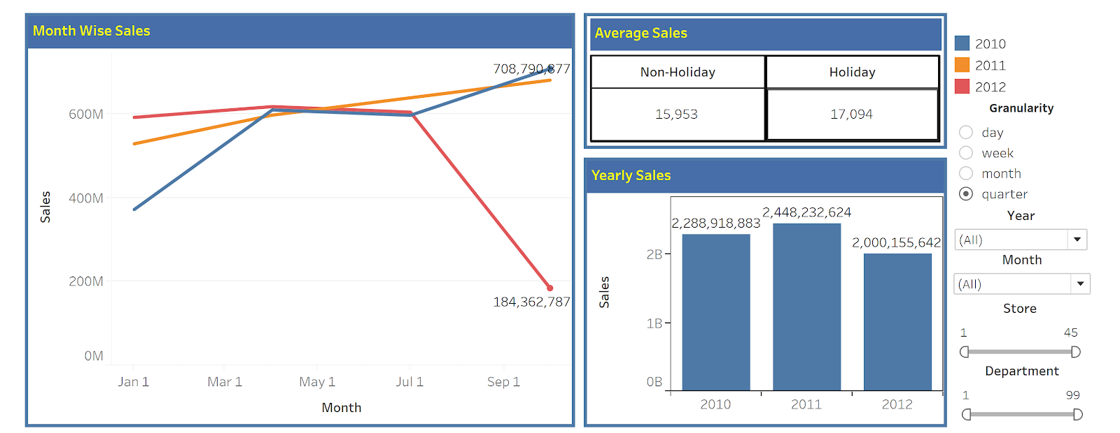
Results

Slide 13
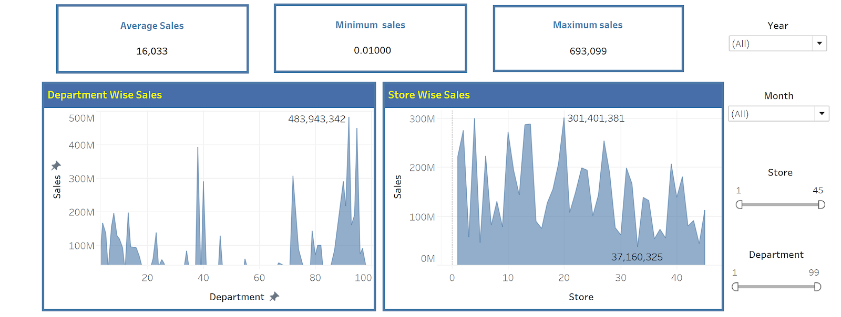

Slide 14
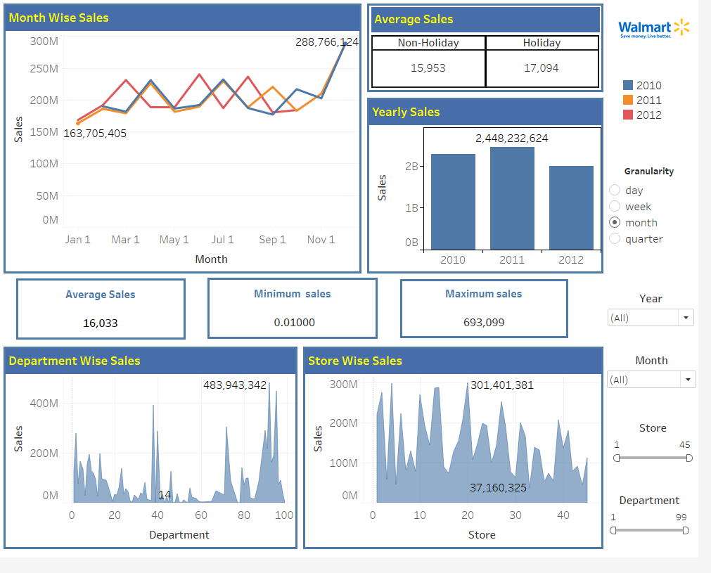
DASHBOARD

Slide 15
Data Analysis
Which type of stores performed better than others?
Can we draw any inference regarding temperature being linear in nature towards weekly sales?
Any Dataset abnormalities and how are they affecting the visuals?
How variant are the sales variance in different stores?
Holiday Vs Non-Holiday weekly sales
Which store and department has maximum and minimum sales?

Slide 16
Discussion
Every problem will have a solution .. We just have to find it.
Our project on Walmart Sales Analysis expectation is to make retailers understand the root cause behind their sales and implement strategies accordingly to make profits out of their business.
Monthly sales
Yearly sales
Containers on KPI
Department wise sales
Store wise sales

Slide 17
Future Work
Implement the dashboard for all the Walmart store in every state of USA.
Considering more KPI calculations like profit, loss etc. from the sales happened.
Now we have implemented for the managers of some stores, we can do a future work by implementing for the leadership level.

Slide 18
Course Work Implementation
Made sure chart is easily understandable for the color-blind people by using the color blindness simulator.
High level of information is placed at the center of the dashboard and detailed information is placed around it.
Some of the visuals also support the gestalts laws of perceptual growth.

Slide 19
What did we learn from project?
We searched for the dataset that best suits our plan of project.
For merging file(4 files), we used two tools that are pyspark in jupyter Notebook to create a data frame.
Used the spark sql to filter all the negative values found in the dataset.
Loaded the dataset into the tableau.
Creative thinking to show the data and KPI values into visuals.

Slide 20
References
[1] : G. Eason, B. Noble, and I. N. Sneddon, “On certain integrals of Lipschitz-Hankel type involving products of Bessel functions,
[2] : A. S. Harsoor and A. Patil, “Forecast of sales of Walmart store using Big Data application,” International Journal of Research in Engineering and Technology, vol. 4, p. 6, June 2015.
[3] : M. Zaharia, M. Chowdhury, T. Das, A. Dave, J. Ma, M. Mccauley, M. J. Franklin, S. Shenker, and I. Stoica, “Fast and interactive analytics over Hadoop data with Spark,” Usenix - The Advanced Computing Systems Association, 2012.
[4] : A. Katal, M. Wazid, and R. H. Goudar, Big Data: Issues, Challenges, Tools and Good Practices, 2013.
[5] : J. Dean and S. Ghemawat, MapReduce: simplified data processing on large clusters. Association for Computing Machinery, 2008.

Slide 21


Slide 22


